Slide 1


HCI Final Presentation
Charles Rodgers (A-B), Divyajitsinh Mahida (C-F), Richard Faulkner (D-E)

Slide 2

Project Description
Assume that there is a company that sells curated, interesting routes through a national park to tourists. A route is a sequence of waypoints that a tourist should follow to experience various things such as interesting animals, plants, or views. Some of these animals may migrate, and the views may change with seasons, so these waypoints may be changing. The company wants a program to allow them to see what routes and waypoints they have. They also want to be able to modify the routes and waypoints, to add and remove new ones as their scouts in the park are discovering new information.

Slide 3


A
Add new waypoints (the waypoint data must be visible and accessible immediately);
User will be able to add new waypoints in the interface.

Slide 4
B
Modify waypoints (must allow all waypoint's properties to be changed);
User will be ablet to modify any waypoints and make changes accordingly.

Slide 5
C
Delete waypoint (this must also remove that waypoint from each and every route at once, as if it never existed);
User will be able to delete any waypoint from the route in the interface.

Slide 6


D
Add new route (the route data must be visible and accessible immediately);
User will be able to add new route to the interface and it will be visible.
These new routes are enabled by clicking on the Add Route button in the Route Panel.
Notes:
The add new route function gives the user the ability to quickly and easily create new routes. This allows for easy modification at any time as soon as new treks are added. The add route feature grants a necessary action to the interface to help keep the user satisfied.

Slide 7
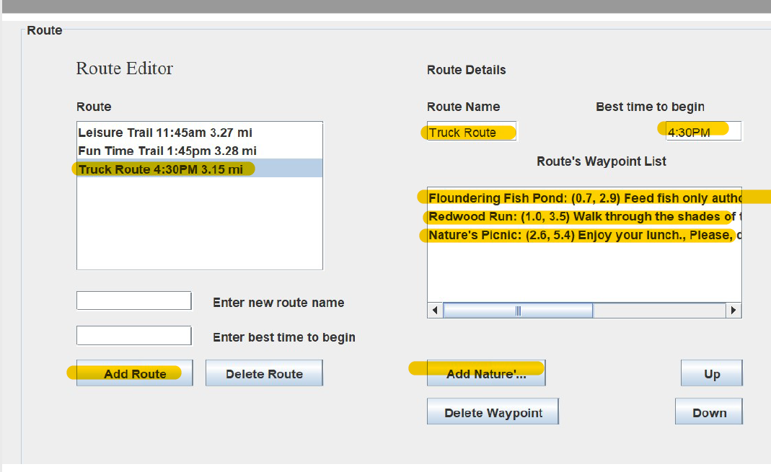
D-1
Here you can see the interface with the Add New Route feature being utilized.
Notes:
The add new route function gives the user the ability to quickly and easily create new routes. This allows for easy modification at any time as soon as new treks are added. The add route feature grants a necessary action to the interface to help keep the user satisfied.

Slide 8

E
Modify route (must allow all route's properties to be changed, including the sequence of waypoints);
User will be able to modify route, it will allow user to change properties of route and sequence of waypoints as well.
Notes:
The modify route feature can be accomplished through the Route’s Waypoint List section of the Route Panel. Users can quickly and easily modify what sights and activities the customer will be able to take part in given the particular route the customers choose. The interface user can delete a waypoint that is not available at that time or rearrange the sequence of the events based on weather changes, or maintenance being completed. Once a route is modified through the waypoint changes, the user instantly knows what the precise distance changes are to the route.

Slide 9
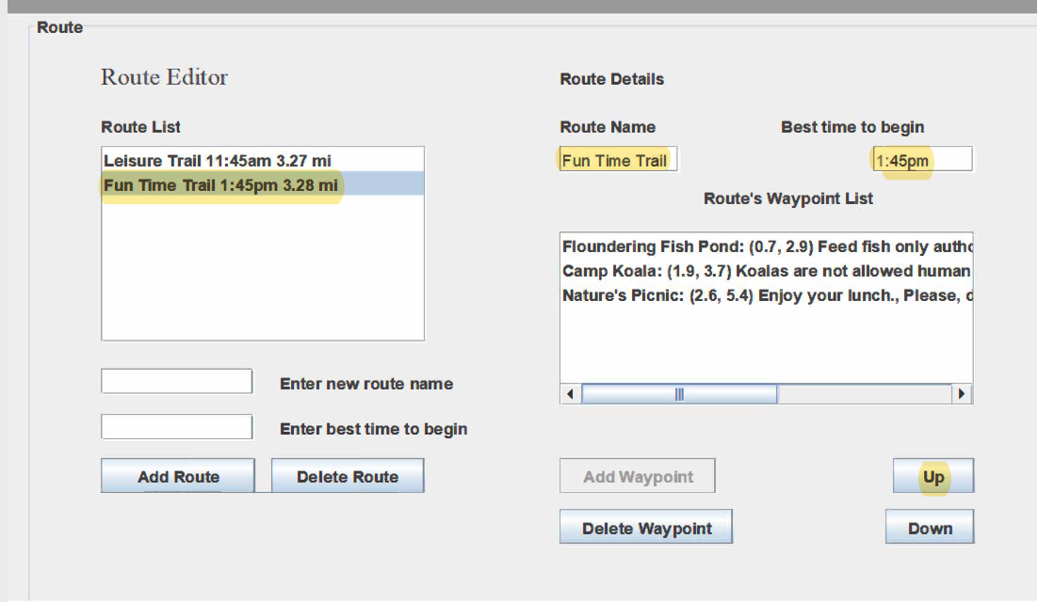
E-1
In this example, the waypoint have been moved and the sequence changed. The route is updated at the same time.
Notes:
The modify route feature can be accomplished through the Route’s Waypoint List section of the Route Panel. Users can quickly and easily modify what sights and activities the customer will be able to take part in given the particular route the customers choose. The interface user can delete a waypoint that is not available at that time or rearrange the sequence of the events based on weather changes, or maintenance being completed. Once a route is modified through the waypoint changes, the user instantly knows what the precise distance changes are to the route.

Slide 10
F
Delete route (route no longer shows up in the interface, as if it never existed);
User will be able to delete route from the interface and user won’t see that route anymore in the interface.

Slide 11

G
Automatically update and show all routes' total length whenever a change is made (for example, order of waypoints is modified for one of the routes, or waypoints are modified or deleted);
After making changes in the waypoints sequence, it will update and show total length to user whenever changes are made in interface.
Notes:
The interface is programmed to refresh the route list data each time an update is made. If the route has the sequence of events changed, the length is automatically recalculated to show the new data. In the event a waypoint is added or deleted, again the route is refreshed, and distance is calculated. The user will never have to guess the new distance.

Slide 12

H
Automatically show waypoints that are not used in any route (or mark them somehow) and automatically update this whenever necessary (for example, routes are modified or deleted)
The waypoints that are not used in any route will have mark indicating '*', so user would be able to know which waypoints are not used in any route.
Notes:
Any time a new waypoint is created, the system will mark it with an asteric showing that the waypoint is not in use. This astric also shows up when a particular waypoint has been deleted or removed from all routes. This allows for easy notices that the waypoint is available or, in the case of a waypoint being out of service for a temporary period, the user can easily see if it has been taken out of use in the interface.

Slide 13
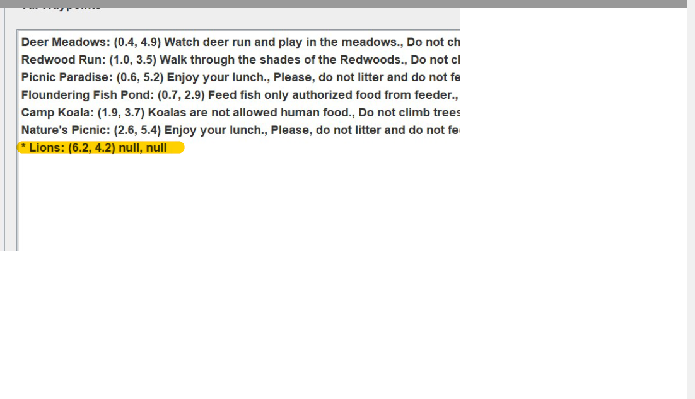
H-1
Here you can see the unused waypoint in marked for easy identification.
Notes:
Any time a new waypoint is created, the system will mark it with an asterisk showing that the waypoint is not in use. This asterisk also shows up when a particular waypoint has been deleted or removed from all routes. This allows for easy notices that the waypoint is available or, in the case of a waypoint being out of service for a temporary period, the user can easily see if it has been taken out of use in the interface.

Slide 14
HCI Issues
Issues a user may have can be adaptability. The interface is very basic and is not overloaded with features. New features would be able to be added at a later time, it would take more programming and coding to add more features, and this could cause the user to be disappointed or upset.
Another issue could be ease of use. While the interface may seem self explanatory to some, others may find it difficult to use. Information could easily be entered wrong and cause the client many issues.

